Slide 1
Project acronym: QFORTE Project title: QFORTE - Enhancement of Quality Assurance in Higher Education System in Moldova (Ref. nr.: 618742-EPP-1-2020-1-MD-EPPKA2-CBHE-SP) 4th Consortium meeting Report Cahul State University “Bogdan Petriceicu Hasdeu” February 7th, 2023
Elena Mandaji USC Institutional Coordinator

Slide 2
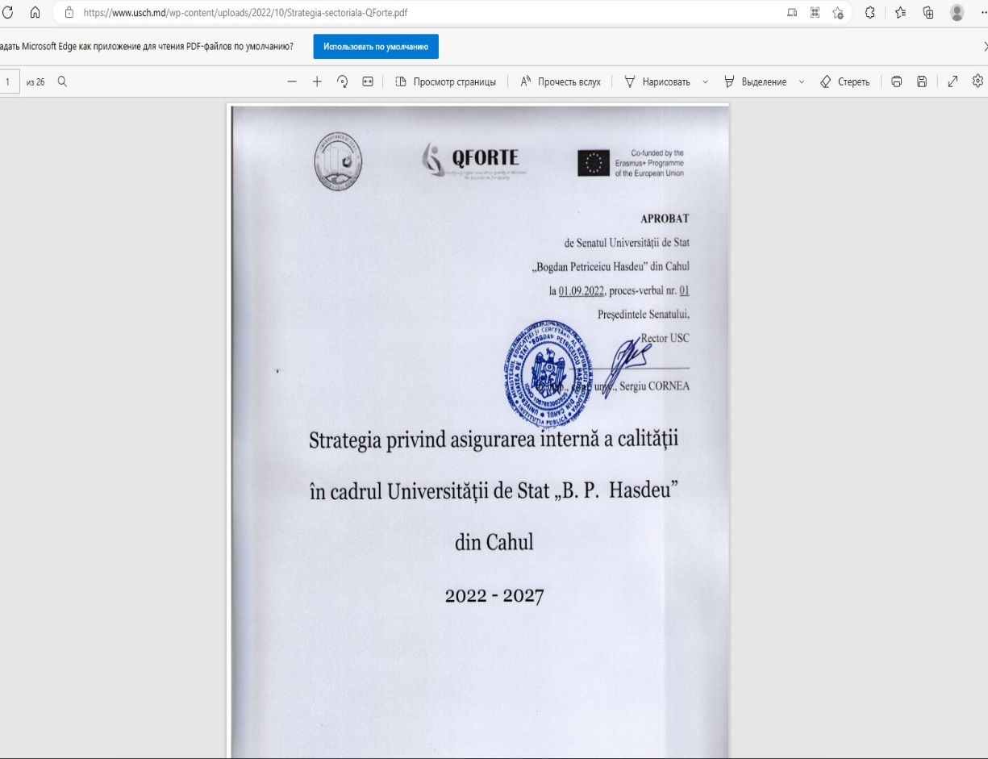
Strategy
On September 1st , 2022, during the meeting of the Senate of the Cahul State University was approved the Strategy on Internal Quality Assurance and the Action Plan.
The approved Strategy could be found at the institutional web page: https://www.usch.md/wp-content/uploads/2022/10/Strategia-sectoriala-QForte.pdf

Slide 3
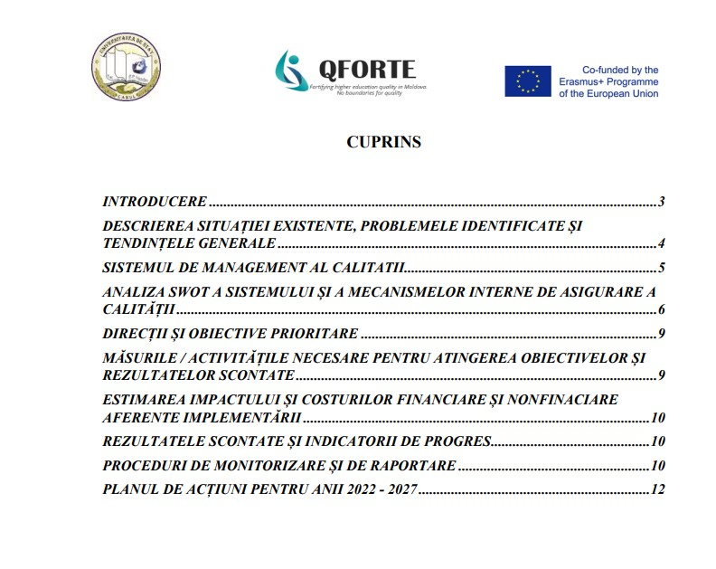
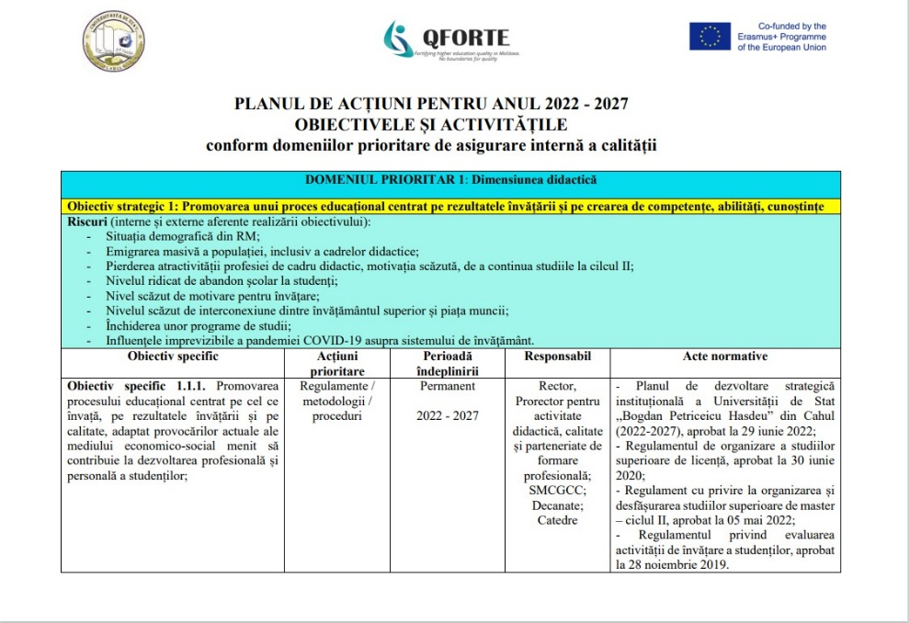
Strategy
Both the Strategy and the Action Plan were developed according to the instructions previously established in agreement with the project coordinator.

Slide 4
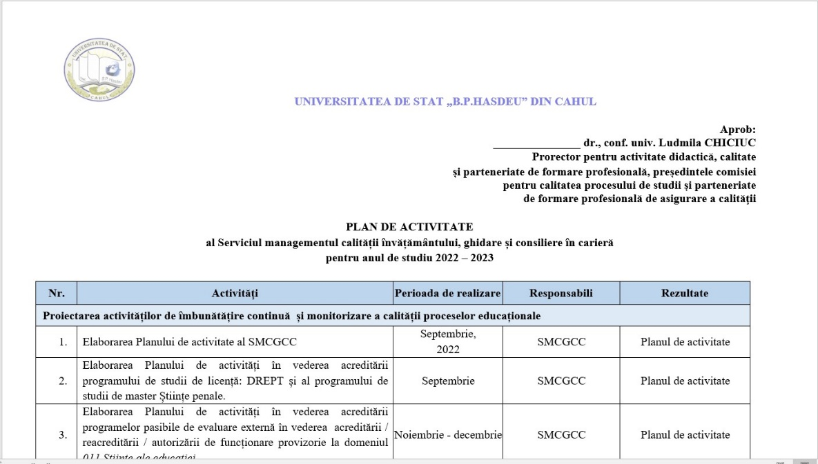
Quality assurance structure
Quality management consists of a set of policies and instruments that determine and measure quality parameters in all fields of activity. The instruments are:
Quality textbook
Procedures textbooks
Structure’s activity plan.

Slide 5
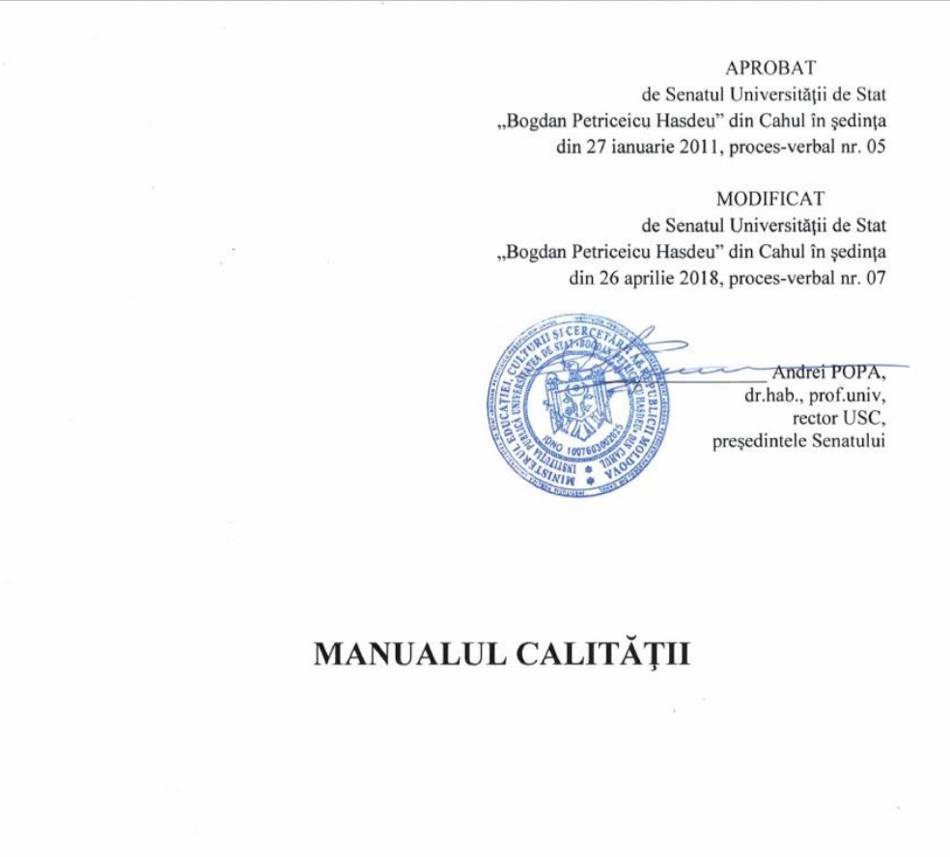
Quality assurance structure
Number of the persons, who is involved at the quality management body – 4:
Head of the Department of Quality Management
3 specialists per each faculty.

Slide 6
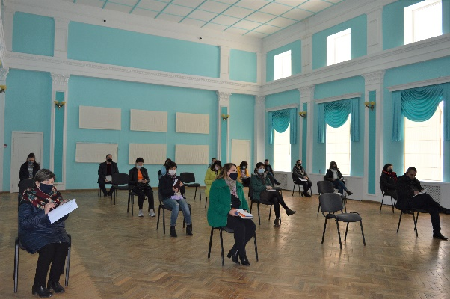
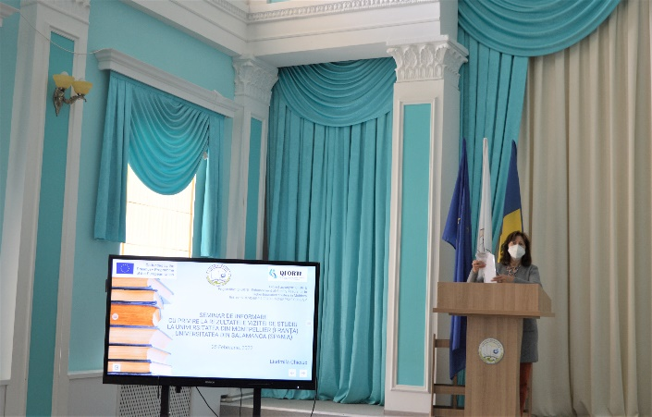
Seminar_February 25, 2022
On February 25, 2022, within USC was organized training seminar, where were presented the knowledge and experience obtained during the study visit to the University of Montpellier (France) and the University of Salamanca (Spain). Within this session the university staff get relevant skills-building needed for strengthening institutional capacities for the implementation of QA reform.
At the seminar were participated 18 academic staff.

Slide 7
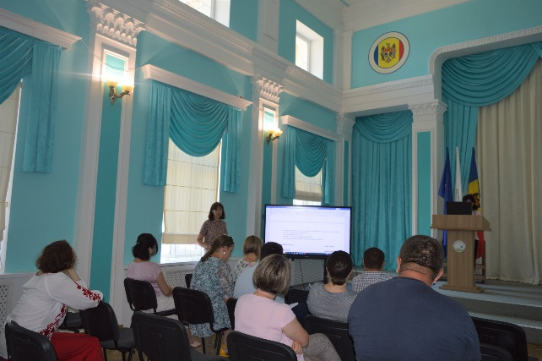
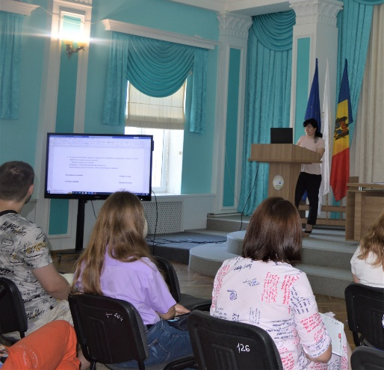
Seminar_April 21, 2022
On April 21, 2022, within the USC was organized a training session for university staff. During this event, the representatives of the QFORTE project implementation team from USC presented: the German accreditation system and quality assurance management structures of the University of Leipzig; was described the experience of international institutional accreditation, namely the legal framework, concept, methodology, procedures and best practices of the Central Evaluation and Accreditation Agency (ZevA) in Germany; also the USC’ staff get familiar with the Draft of the Strategy on Internal Quality Assurance and the Action Plan.

Slide 8
Dissemination
All the information regarding the QFORTE project is placed at the QFORTE institutional web page, that was created within the suggestions that were made at the Communication and Dissemination Strategy. Here is the link: https://proiecte.usch.md/despre-qforte/

Slide 9
Thank you for your attention!!!

