Slide 1
WP 3: Advancement of University Integrative Function on QA
Dr. Victoria Reinhardt and Dr. Alina Tofan
4th Consortium Meeting, Chisinau, 7th February 2023

Slide 2
Report on WP 3 Implementation stage/next activities
D3.1 Elaboration and adoption of Institutional strategies on QA
- Short report on the study visit in Leipzig
D3.2 Modernisation and adoption of QA Manuals at institutional level
D3.3 Performance on International institutional accreditation
- Short report on the seminar on institutional QA in Leipzig

Slide 3
D3.1 Elaboration and adoption of Institutional strategies on Quality Assurance
A3.1.1/ Setting up the university QA working groups (UQA): Each partner university in Moldova will nominate member of UQA1 and UQA2. 14.03.2021
A3.1.2/ Study visits on UQA strategy development: Each project`s partner (members of the UQA1 and UQA2.) will participate in the study visit to the University of Montpellier/FRANCE (P10-UM/FR). May 2021
A3.1.2/ Study visits on UQA strategy development: Each project`s partner (members of the UQA1 and UQA2.) will participate in the study visit to the University of Salamanca /SPAIN (P11- USAL/ES). November 2021
A3.1.2/ Study visits on UQA strategy development: Each project`s partner (members of the UQA1 and UQA2.) will participate in the study visit to the Leipzig University / GERMANY (P12-ULEI /DE) March 2022
A3.1.3/Development, adoption of institutional QA strategies: each PCU under the consultation of the WP3` Leader (P12-ULEI/DE) and co-leader (P11- USAL/ES) will elaboarte University Strategies on quality assurance (including Action plan) 14.06.2022
A3.1.4/Translation and e-publishing of institutional quality assurance strategies: The Strategies will be elaborated in the national language (MD) and translated to English. 14.04.2023
OUTPUT: Two (2) UQA working groups formatted in each PCU; Three Study visits to EU realised ; 7 institutional structures of the PCUs consolidated (M24)

Slide 4
Study visit at the Leipzig University (14-16 March 2022)
Three working sessions on the quality assurance (QA) system at the Leipzig University
First session: System Accreditation at the Leipzig University (embedment of QA in Strategy Development at the Leipzig University, QA actors and structures at Leipzig University, Evaluation and certification of university degrees)
Second session: QA System at the Faculty of Social Sciences and Philosophy (processes and QA instruments for development, evaluation and accreditation of study programmes, experiences with the evaluation of international study programmes and specific challenges related to the accreditation of joint degree study programmes based on the European approach)
Third session: Insights in the process of international accreditation by the Association to Advance Collegiate Schools of Business (AACSSB) at the Faculty of Economics and Management Science.
A round table on strategy development in the field of QA

Slide 6
D3.2 Modernisation and adoption of QA Manuals at institutional level
A3.2.1/ Modernisation of the universities’ Quality manual: each PCU under the consultation of the WP3` co-leader (P11- USAL/ES) will modernise existing universities’ quality manuals; 14.11.2022
A3.2.2/ e-publishing of the universities’ Quality manual: The Quality manuals will be elaborated in national language (MD) and translated into English. 14.10.2023
OUTPUT: Seven (7) QA manuals elaborated and e-published(M24).
Bilateral meetings planned for 8th and 9th February 2023
ACTIVITY`s LEADER P3-USARB/MD

Slide 7
D3.3 International institutional accreditation performed
D3.3 International institutional accreditation performed
A3.3.1/ Training seminars QA development and International institutional accreditation: All PCU (members of the UQA1 and UQA2) will attend a training seminar dedicated to the university QA capacity building and elaboration of the self-evaluation report for the international institutional accreditation. (A3.1.2) March 2022
A3.3.2/ Developing the application for international accreditation: Each PCU will elaborate self-evaluation reports for international accreditation 14 October 2023
OUTPUT: At least five (5) HEIs accredited internationally (M36)
ACTIVITY`s LEADER P2-ASEM/MD

Slide 8
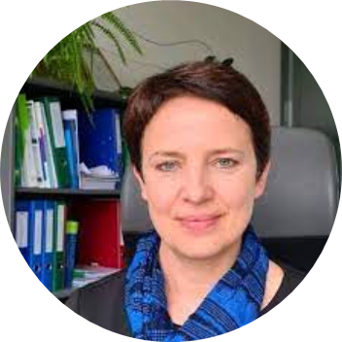
Seminar "International institutional accreditation: methodology and procedures" (Leipzig, 29-30 March 2022)
Key presentations:
Anja Grube (Central Evaluation and Accreditation Agency (ZEvA), Head of Institutional Accreditation & International Affairs): "Institutional accreditation: legal framework, procedures and methodology”.
Dr. Sonja Mikeska (Higher Education Manager & Consultant, Centre for Quality Assurance and Enhancement, Wandelwerk - FH Münster): experiences and good practices in the field of institutional accreditation at FH Münster, experiences in international institutional accreditation as well as the challenges & opportunities in this field.
Nora Skaburskiene (Director of Academic Affairs Office, Vilnius Gediminas Technical University, Lithuania): International institutional accreditation: the experience of Lithuanian Universities.
Round table on international institutional accreditation for Moldovan HEI: legal framework, requirements, goals, financing conditions, possible scenarios and challenges, moderated by Dr. Nadejda Velisco and Dr. Victoria Reinhardt, with the active participation of Anja Grube, Nora Skaburskiene, Dr. Christine Taube, Denis Keune, representatives of QFORTE-partner.

Slide 9
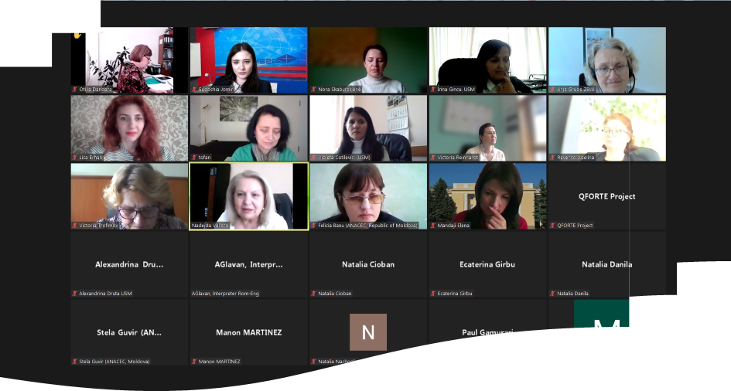
Seminar "International institutional accreditation: methodology and procedures" (Leipzig, 29-30 March 2022)

Slide 10
TO DO
A3.2.2/ e-publishing of the universities’ Quality manual
Seven (7) QA manuals elaborated and e-punlished(M24).
each MD HEIs
e- publishing
March`23
The Quality manuals will be elaborated in national language (MD) and translated into English.
A3.3.2/ Developing the application for international accreditation
At least five (5) HEIs accredited internationally (M36)
P1-USM/MD One (1) Report for International accreditation
P2-ASEM/MD One (1) Report for International accreditation
P3-USARB/MD One (1) Report for International accreditation
P4-USC/MD One (1) Report for International accreditation
P6-AMTAP/MD One (1) Report for International accreditation
Oct`23/ accredited

Slide 11
Thank you!

