Slide 1
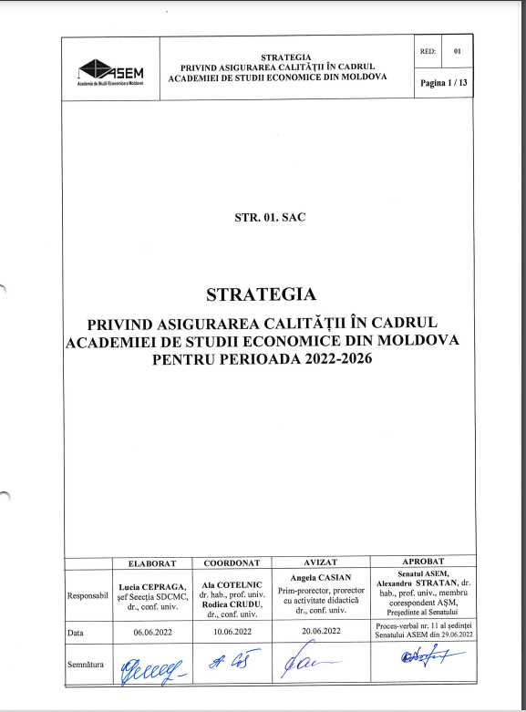
ASEM
WP3: Advancement of university integrative function on QA
ASEM Strategy for Quality Assurance for 2022-2026,
approved on 29.06.22
https://ase.md/files/legal/interne/1.6_Strategia_Calitate.pdf
The Manual of Quality Management System, approved on 24.12.2020
https://ase.md/files/legal/interne/1.5_manualul_smc_r02.pdf
Still working on developing new procedures
4TH CONSORTIUM MEETING
07 February 2023 / Chisinau, Moldova

Slide 2
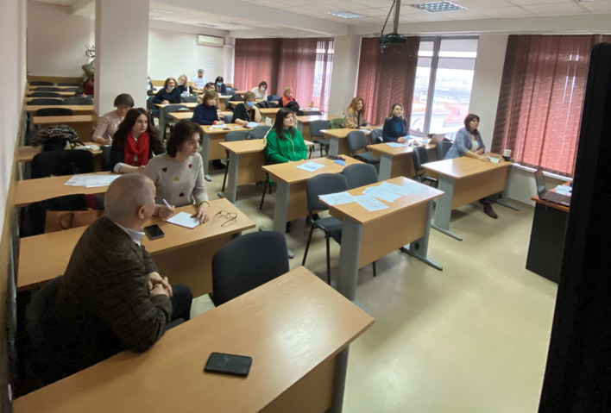
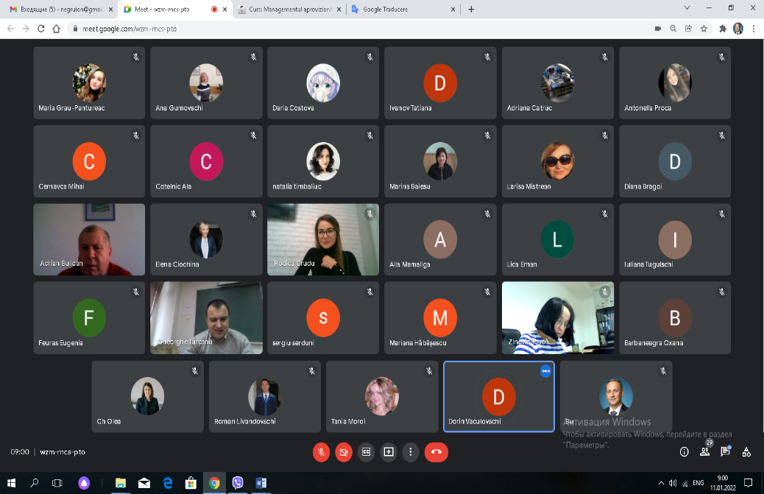
ASEM
WP4: Enhancement of institutional capacities for implementation of QA reform
Training seminar “Quality Assurance in Higher Education Institutions”, 10-12 January 2022, 63 participants (28 on-site +35 online)
4TH CONSORTIUM MEETING
07 February 2023 / Chisinau, Moldova

Slide 3
ASEM
WP4: Enhancement of institutional capacities for implementation of QA reform
QA management system is ensured by the managers of each level (university – rector, faculty – dean, department – head of department, section – head of the section, etc.)
ASEM QA structures:
Quality Assurance Board - university level (13 people, including 2 students/masters)
Studies, Curriculum Development and Quality Management Section - at institutional level 8 persons;
Quality Assurance Commission - at faculty, master school and doctoral school level (in ASEM there are 8 Commissions with a total of 54 members);
Quality Assurance Committee - at departmental level (14 Committees are active in ASEM, with a total of 72 members);
Quality assurance officer - at subdivision level (each subdivision has 1 or 2 quality assurance officers, total in ASEM - 22 officers).
TOTAL – 84 persons involved in QA

Slide 4
Project acronym: QFORTE
Project full title: ENHANCEMENT OF QUALITY ASSURANCE IN HIGHER EDUCATION SYSTEM IN MOLDOVA
Project No: 618742 -EPP-1-2020-1-MD-EPPKA2-CBHE-SP
Funding Scheme: Erasmus+
WP6 Implementation stage/next activities
4TH CONSORTIUM MEETING
07 February 2023 / Chisinau, Moldova
Speaker: Rodica CRUDU
Institution: Academy of Economic Studies of Moldova
https://qforte.usm.md/

Slide 5
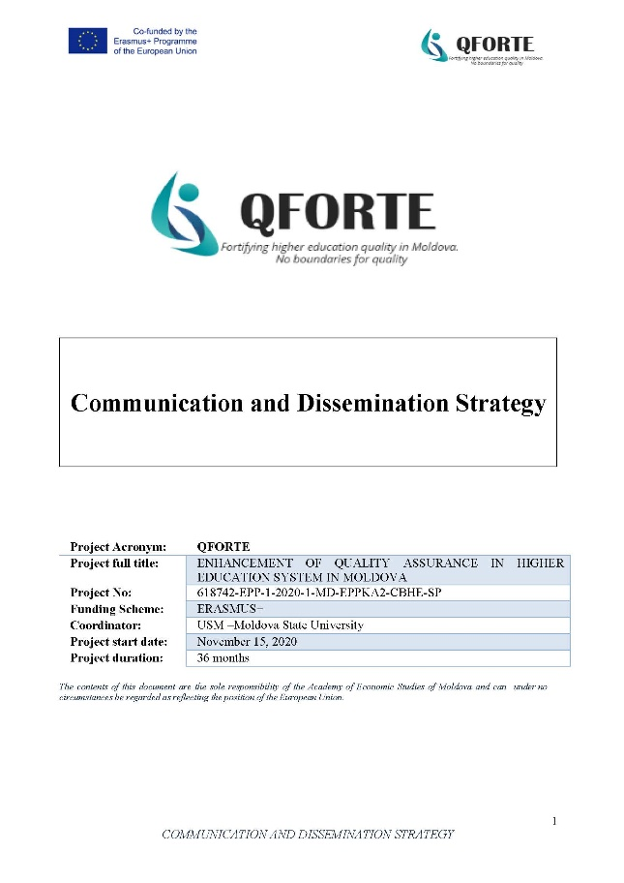
A6.1.1./ DISSEMINATION STRATEGY
WP6: Dissemination, exploitation and impact maximization
Available on TRELLO:
https://trello.com/b/VN2baFbl/qforte
https://qforte.usm.md/

Slide 6
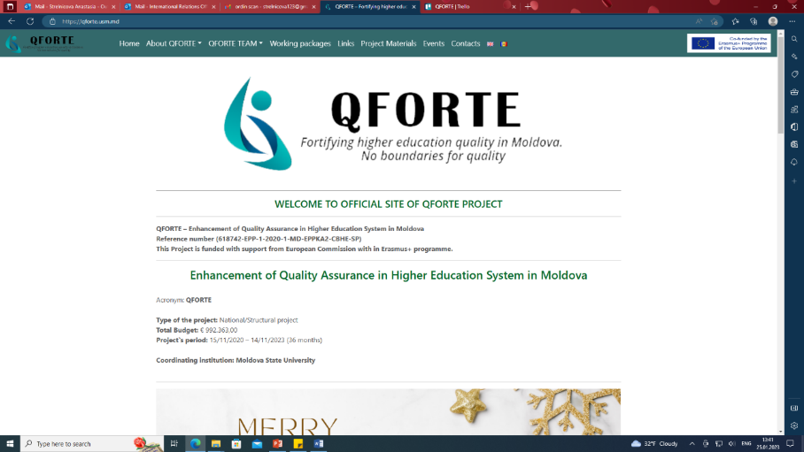
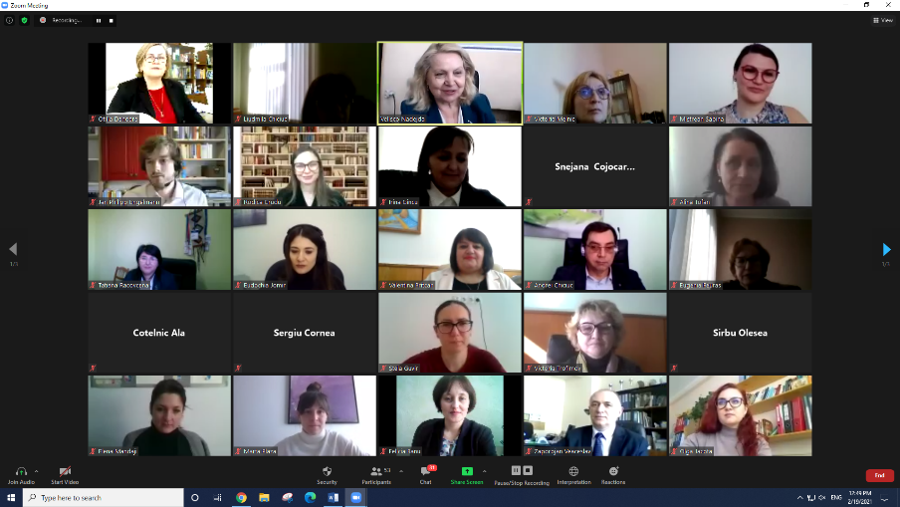
A.6.1.3. / Launching conference
WP6: Dissemination, exploitation and impact maximization
A6.1.2./ WEB PAGE & SOCIAL MEDIA
DONE: LAUNCHING CONFERENCE/ 19th February 2021
https://qforte.usm.md/

Slide 7
A6.2./ National campaign quality assurance realized
NATIONAL LEVEL |  | 15.11.2020 - 14.11.2021 | 15.11.2021 - 14.11.2022
3. | INFORMATION DAYS AND PUBLIC APPEARANCES | - | 1
4. | NATIONAL CONFERENCES/ WORKSHOPS/ SEMINARS | - | -
5. | MASS-MEDIA APPEARANCE articles published in national mass media | 6 | 5
INTERNATIONAL LEVEL
6. | INTERNATIONAL CONFERENCE/ WORKSHOPS/ SEMINARS/ARTICLES | 1 | 4
https://qforte.usm.md/

Slide 8
A6.3./ University campaign on institutional quality assurance realised
WEB PAGE & SOCIAL MEDIA: institutional dissemination channels used by partners
QFORTE Institutional Web page in national language:
Institutional Facebook page in national language
Partner Institution | Web page link:
P1-USM | https://international.usm.md/?page_id=814
P2-ASEM | https://bri.ase.md/qforte/
P3-USARB | https://usarb.md/qforte/
P4-USC | https://proiecte.usch.md/1-lansarea-proiectului-qforte/
P5-KDU | https://kdu.md/ru/nauka-i-mezhdunarodnye-svyazi/proekty/proekt-qforte
P6-AMTAP | https://amtap.md/ro/despre-qforte.html
P7-USPEE | https://uspee.md/cooperare-internationala/proiecte/qforte/
https://qforte.usm.md/

Slide 9
A6.3./ University campaign on institutional quality assurance realized: OVERVIEW
INSTITUTIONAL LEVEL |  | 15.11.2020 - 14.11.2021 | 15.11.2021 - 14.11.2022
1. | INSTITUTIONAL DISSEMINATION EVENTS | 7 | 11
2. | INSTITUTIONAL NEWSPAPER/BULLETIN (ARTICLES/NEWS): | 1 | 2
3. | INSTITUTIONAL WEB PUBLICATIONS | 30 | 46
4. | INSTITUTIONAL SOCIAL MEDIA PUBLICATIONS | 17 | 12
https://qforte.usm.md/

Slide 10
A6.3./ University campaign on institutional quality assurance realized: BY PARTNER UNIVERSITY
Partner Institution |  | INSTITUTIONAL LEVEL |  |  | NATIONAL LEVEL |  |  |  | INTERNATIONAL LEVEL
 |  | Institutional Dissemination Events | Institutional Newspaper/Bulletin | Web & Social media | Info days | Conferences/Workshops | Mass-media | Articles | Conferences/ Workshops/ | Articles
1. | P1-USM | 4 | - | 9 | 1 | - | - | - | - | -
2. | P2-ASEM | - | - | 24 | - | - | 9 | - | - | 1
3. | P3-USARB | 2 | - | 18 | - | - | - | - | - | -
4. | P4-USC | - | - | 14 | - | - | - | - | - | 2
5. | P5-KDU | - | - | 17 | - | - | - | - | - | -
6. | P6-AMTAP | 2 | - | 11 | - | - | - | - | - | 1
7. | P7-USPEE | 10 | 2 | 11 | 1 | - | - | 2 | - | 1
https://qforte.usm.md/

Slide 11
Dissemination Activities of Partner Universities for:
15.11.2022- 14.11.2023
Activity: |  | Total number of activities to be reported:
(6.1.2.) | Design of project`s identity, promo materials &web page | 1 Project web page; Number of institutional web pages;
(6.1.3.) | Launching and Concluding conferences | 2 events;
(6.1.4.) | Inter-project coaching | 3 inter-project coaching meeting organized;
(6.2.1) | Country Workshops | 3 Country Workshops realized;
(6.2.2.) | Mass-media dissemination | 5 articles published on national level;
(6.3.1.) | Institutional dissemination events | At least 2 institutional Dissemination events by each PCU;
(6.3.2.) | Publication of articles | At least 3 articles published by each PCU;
(6.4.) | TG satisfaction survey | One survey completed by each partner;
https://qforte.usm.md/

