Slide 1
Erasmus Mundus Joint Master in Global Studies
Stephan Kaschner, 15 March 2022

Slide 2
International MA Programmes at the Global and European Studies Institute
„Global Studies – A European Perspective“
„Global Studies with a Special Emphasis on Peace and Security in Africa“ (with Addis Ababa University)
„European Studies“ (ARQUS University Alliance)

Slide 3
Basic Information
two-year transnationally organized Master‘s programme
founded in 2005 by four different universities based in Europe
Today 6 European universities and 9 non-EU partners
courses are offered in English
international composition of the student body
funded by the European Union‘s excellence programme „Erasmus Mundus“
Approx. 80-100 students per intake overall the consortium

Slide 4
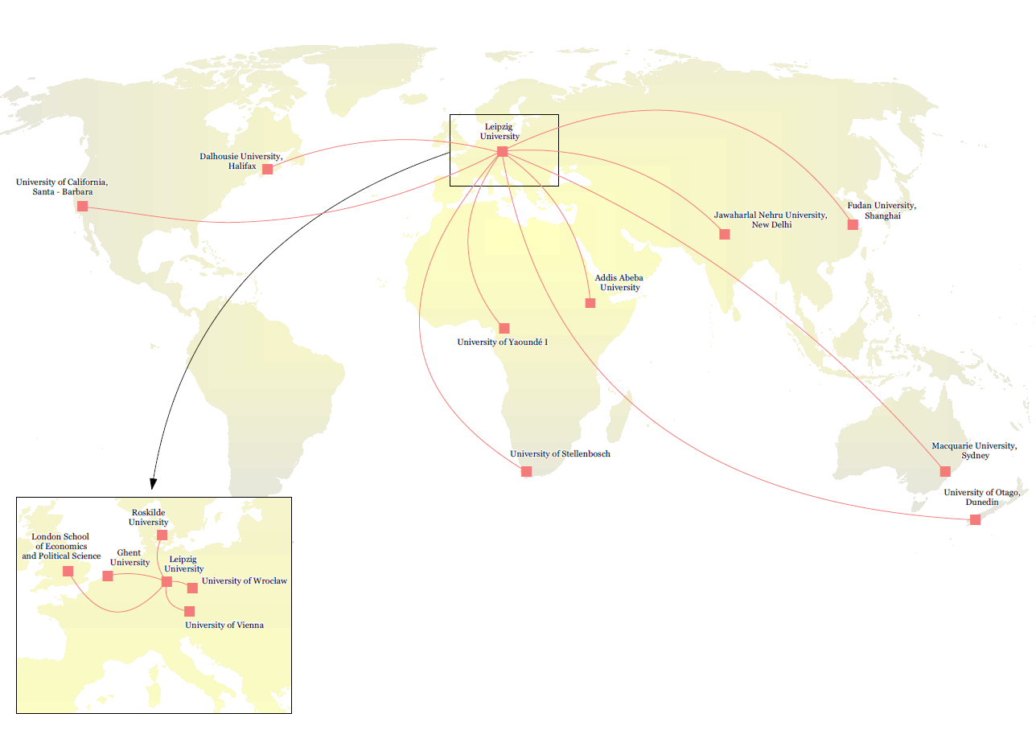
The EMGS Consortium
© E. Baraniecka

Slide 5
Curriculum and Mobility Tracks
Term 1: Introduction to the understanding of Global Studies to develop a multidisciplinary understanding of processes of globalization
Term 2/3: Studying concrete phenomena from at least two different world regions and their entanglements and transregional ties
Term 3: Optional exchange semester at a non-EU partner university
Term 4: Master-Thesis and advanced research seminars helping students to frame their individual work within the larger research agenda of Global Studies

Slide 6
Carreer Options
„Global Studies – A European Perspective“
Research and Higher Education
Public Administration
Development Cooperation
International Organisations and Diplomatic Service
Politics and Policy Advice
Media
…

Slide 7
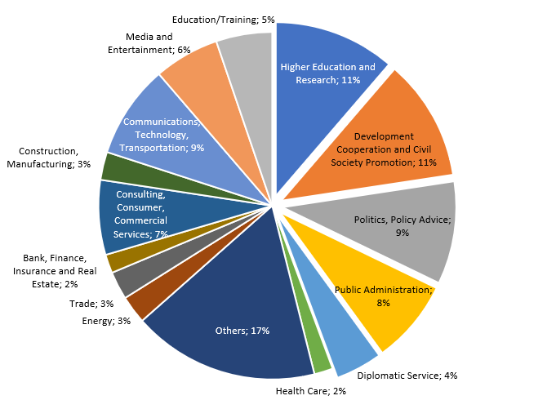
Carreer Options II
„Global Studies – A European Perspective“

Slide 8
EMGS
Joint Quality Assurance Mechanisms

Slide 9
Joint Quality Assurance in a Joint Programme
Different levels of QA in the Consortium:
1) Local level
Evaluation of individual courses and modules(organized by local partners)
Local meetings of Study and Examination Commitees with students representatives
Regular online lecturer meetings

Slide 10
Joint Quality Assurance in a Joint Programme
Different levels of QA in the Consortium:
2) Consortium level
At least twice a year (summer and winter school): joint meeting of student representatives and local coordinators
Since 2020/21: intensified online Consortium Meetings including consortium student representatives
Every 1-2 years: joint online survey for the entire progamme
Every 5 years: Alumni Meeting and Alumni Survey

Slide 11
Joint Quality Assurance in a Joint Programme
Different levels of QA in the Consortium:
3) External Review and Accreditation
Accreditation (European Approach)
Advisory Board
Advisory Board on Employability

Slide 12
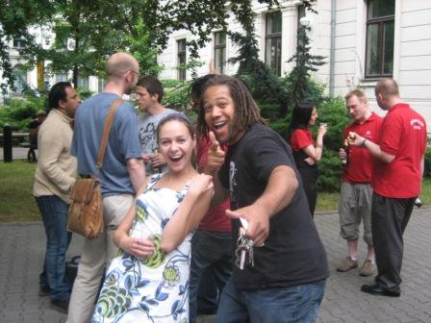
Thank you for your attention!

