Slide 1
Project acronym: QFORTE Project title: QFORTE - Enhancement of Quality Assurance in Higher Education System in Moldova (Ref. nr.: 618742-EPP-1-2020-1-MD-EPPKA2-CBHE-SP) Illustration : QA from a French university perspective : Université de Montpellier / University of Montpellier (UM) Country workshop 30 September, 2021

Slide 2
CONTENTS

Slide 3
CONTENTS
Higher education system in France
Goals of QA assurance system
Areas covered by QA system
External QA in France
Internal QA system
QA institutional strategy and action plan

Slide 4
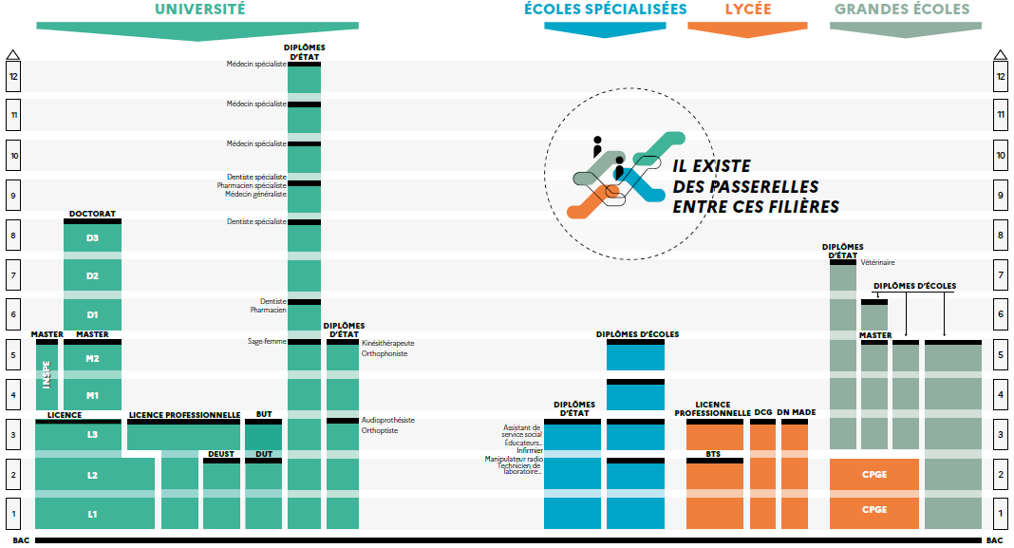
French HE system
Source: ONISEP, 2021

Slide 5
GOALS & PURPOSES
Based on the Standards and Guidelines for Quality Assurance in the European Higher Education Area (ESG). (2015). Brussels, Belgium.
ESG purposes:
-- Setting acommon framework for quality assurance systems for learning and teaching at European, national and institutional level;
-- Enabling the assurance and improvement of quality of higher education in the European higher education area;
-- Supporting mutual trust, thus facilitating recognition and mobility within and across
national borders;
-- Proving information on quality assurance in the EHEA (and beyond …)

Slide 6
Areas covered by QA system
Mainly : teaching, research, services, quality monitoring
but also
research, gender and equality, collaborative partnerships
Ideal aim : all processes
In accordance with
legal frameworks, external QA procedures

Slide 7
External QA in France
Responsible Bodies
Agence d’évaluation de la recherche et de l’enseignement supérieur (AERES–Evaluating Agency for Evaluating Research and Higher Education)
Comité national d'évaluation des établissements publics à caractère scientifique, culturel et professionnel (CNE–National Committee for Evaluating Schools of a Scientific, Cultural and Vocational Nature)
Inspection générale de l’administration de l’éducation nationale et de la recherche (IGAENR–Inspection General of the Administration of National Education and Research)
The Haut conseil de l’évaluation (HCE–High Evaluation Council)

Slide 8
Internal QA
Responsible Bodies
Agence d’évaluation de la recherche et de l’enseignement supérieur (AERES–Evaluating Agency for Evaluating Research and Higher Education)
Comité national d'évaluation des établissements publics à caractère scientifique, culturel et professionnel (CNE–National Committee for Evaluating Schools of a Scientific, Cultural and Vocational Nature)
Inspection générale de l’administration de l’éducation nationale et de la recherche (IGAENR–Inspection General of the Administration of National Education and Research)
The Haut conseil de l’évaluation (HCE–High Evaluation Council)

Slide 9
Internal QA
Internal evaluations
“In conformity with the autonomy principle for institutions, reinforced by the LRU (law defining liberties, freedoms and responsibilities of French HEI):
the first responsibility in managing the teaching quality of higher education falls to the institution itself, which lays the foundations for instilling responsibility in the university system itself as part of the national quality framework.
Procedures for self-assessment (or internal assessment) are implemented in institutions under the urging and follow-up of AERES and the CNE. Self-assessment tools are placed at the disposal of institutions by these bodies, as for example the Livre des références (LDR–Reference Book) by the CNE. This tool is composed of three chapters (training policy, scientific policy and management) that respond to the basic remits of universities. The institution is led to identify its strengths, its weaknesses and its progress; it acquires a global view of how it works”
Source: Eurydice

Slide 10
QA UM institutional strategy and action plan
It is institutional
Strategy and action plan
At the university level : more than 200 people, the President, a VP, one Department in charge,
At the Faculties level
At the Laboratories and Research structures’ level
Documented, publicized, avalaible, supported,

Slide 11
Stakehloders, benefits and challenges
Stakeholders
All !
Benefits
Improvement and recognition
Challenges
Development and sustainability

Slide 12
Thank you for your attention / Merci pour votre attention !

